Slide 1
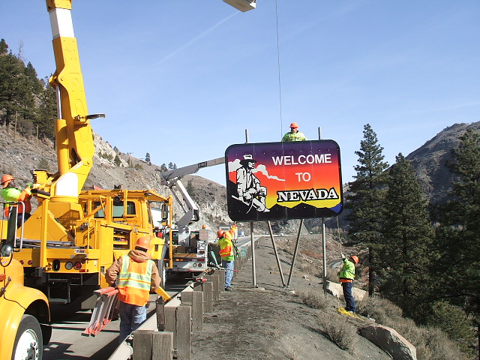
I80 Corridor Coalition 2012 NDOT DII Update
Mike Fuess, PE, PTOE (NDOT)
Thor Dyson, PE, CPM (NDOT)

Slide 2
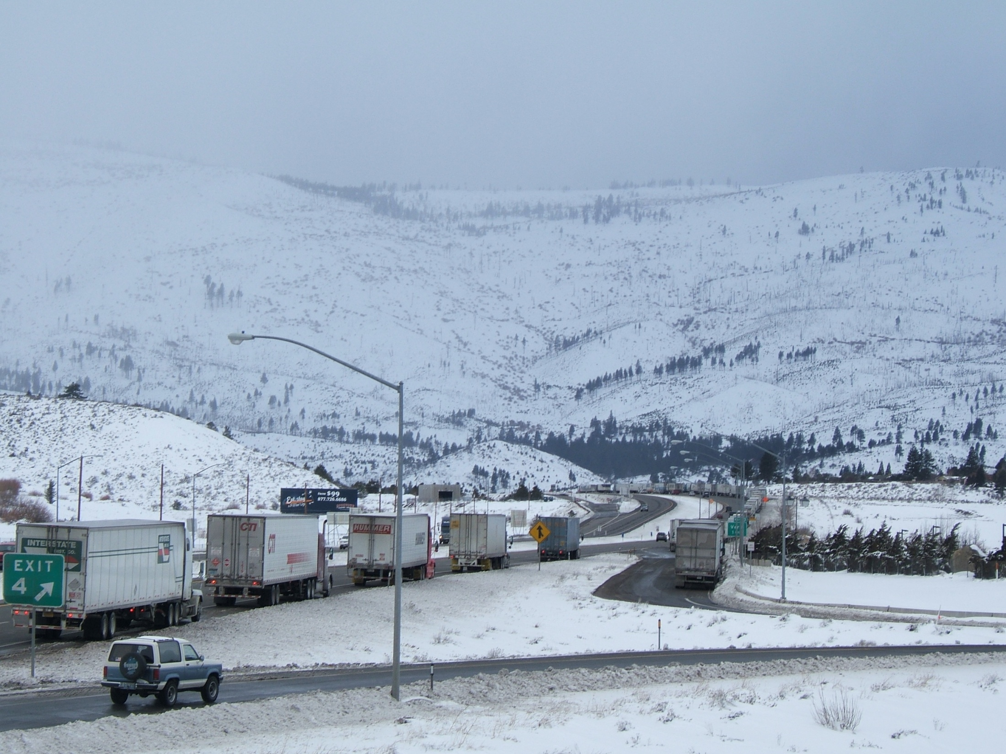

Slide 3
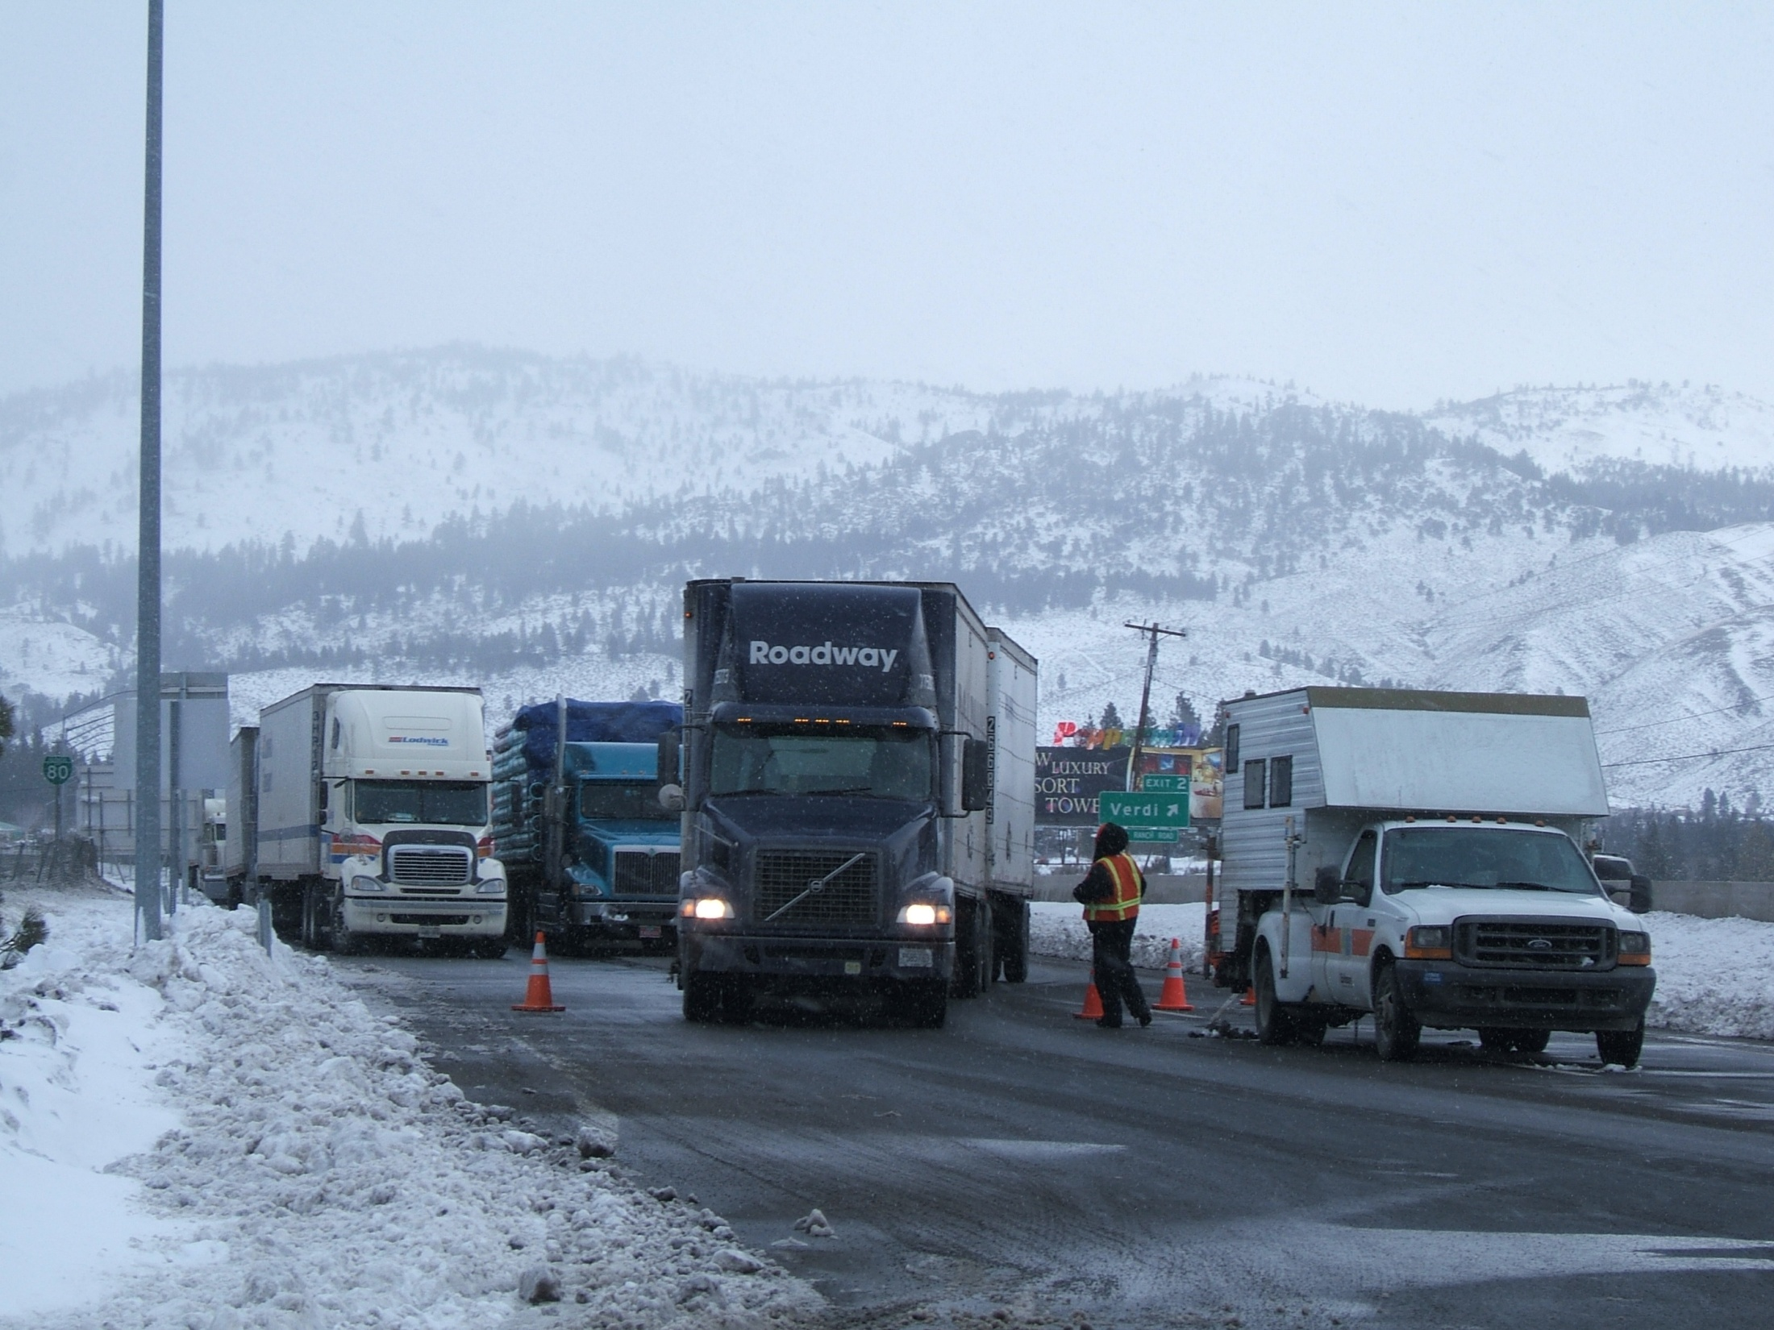
Caltrans Turning Trucks at Exit 1
02/03/08

Slide 4
2011/2012 ~ I80 Interstate Winter Weather Coordination
 | Jan – Mar 2011 | Jan – Mar 2012
Number Truck Prohibitions on I80 | 9 | 2
Number of freeway closures on I80 | 5 | 0
 | Jan – Mar 2011 | Jan – Mar 2012
Duration of Truck Prohibitions on I80 | 113hr 52min | 10hr
Duration of freeway closures on I80 | 53hr 53min | 0
Notes:
The following closures are all on I80:
02/16/11 Closed to trucks @ Gold Ranch 06:45
06/16/11 Open to trucks at 15:30
02/17/11 Close to trucks @ Gold Ranch 00:30
02/17/11 Open to trucks at 08:00
02/17/11 Closed to all traffic @ Gold Ranch 16:10
02/17/11 Open to all traffic 18:00
02/25/11 Closed to trucks @ Gold Ranch 02:05
02/25/11 Closed to all traffic 09:30
02/25/11 Open to cars only 15:30
02/25/11 Open to all vehicles 22:24
03/18/11 Closed to all traffic at Gold Ranch 14:17
03/19/11 Open to cars only 01:00
03/19/11 Open to all vehicles 05:30
03/20/11 Closed to all traffic at Gold Ranch 04:43
03/20/11 Open to cars only 16:10
03/20/11 Open to all vehicles 19:00
03/21/11 Closed to all traffic @ Truckee 19:55
03/21/11 Open to cars only 20:43
03/22/11 Open to all vehicles 04:00
03/24/11 Closed to trucks @ Gold Ranch 08:55
03/24/11 Closed to all vehicles 11:14
03/25/11 Open to cars only 12:09
03/25/11 Open to all vehicles 23:15
03/26/11 Closed to trucks @Gold Ranch 07:27
03/26/11 Open to all vehicles 17:00
02/29/12 Closed to trucks at Boca 06:35
02/29/12 Open to all vehicles 12:50
03/18/12 Closed to all vehicles @ DLI 18:45
03/18/12 Open to all vehicles 22:30

Slide 5
Pavement Temperature

Slide 6
December Snow Fall

Slide 7
January Snow Fall

Slide 8
February Snow Fall

Slide 9
March Snow Fall

Slide 10
Progress this year
I80 Design Build Project
NDOT Fernley Truck Parking Facility
In the process of acquiring 2 tow plows for Northern Nevada
Web access to NDOT systems
Notes:
Estimates show leasing/operate/maintain cost $55/hour and contracting cost
Contracting out cost @215

Slide 11
I80 Design Build Project
Pavement Reconstruction Keystone to 4th
Full ITS deployment from Robb to Vista
New overhead signs
New auxiliary lanes
Emphasis on contractor innovation
Notes:
Trunk line, flow detectors, ramp meters in three locations, corridor HAR, cameras, new DMS

Slide 12
Proposed Leased Truck Parking Facilities

Slide 13
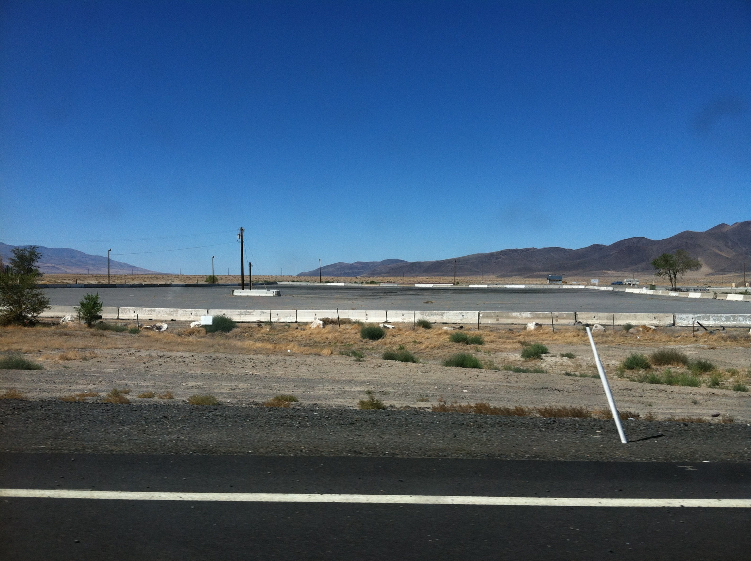

Slide 14
UDOT Tow Plow
Notes:
1 for each District
DII tow plow primarily assigned to I580 extension but will be used on I80

Slide 15
Expectations for this winter
Same plan as previous years
May have more challenges than normal for major events
Interstate conference call

Slide 16
NDOT DII Challenges
Reduced operating budgets
Less maintenance resources
Aging fleet & no new vehicles in 4 years
Retirements
More than normal new hires
Accelerated promotions
Minimal winter weather last year

Slide 17
Graduated Guidelines for Handling I-80 W/B Closures and Truck Prohibitions
Level | Estimated Closure Duration (hrs) | Activate NDOT ITS Devices |  |  | Manned Truck- screening E of Reno
 |  | Permanent DMSs | DMS Message TRUCKS or ALL VEHICLES | Activate "When Flashing" signs at Trinity & Wadsworth
I | < 3 hrs | Reno (4 total),Fernley, Trinity, Humboldt | TURNING TRUCKS XX MILES AHEAD or I-80 CLOSED AT CA STATELINE CALL 511 FOR ROAD INFO | "I-80 Closed to Trucks at Stateline" | No
II | 3 - 6 | Elko, Winnemucca | I-80 CLOSED TO TRUCKS AT CA STATE LINE CALL 511 FOR ROAD INFO or I-80 CLOSED AT CA STATELINE CALL 511 FOR ROAD INFO | "I-80 Closed to Trucks at Stateline" | No
III | 6 - 12 | Wendover, Wells, Elko, Winnemucca | I-80 CLOSED TO TRUCKS AT CA STATE LINE CALL 511 FOR ROAD INFO or I-80 CLOSED AT CA STATELINE CALL 511 FOR ROAD INFO | "I-80 Closed to Trucks at Stateline" | No
IV | 12 - 24 | Wendover, Wells, Elko, Winnemucca | I-80 CLOSED TO TRUCKS AT CA STATE LINE, USE ALT ROUTE CALL 511 FOR ROAD INFO or I-80 CLOSED AT CA STATE LINE USE ALT ROUTE CALL 511 FOR ROAD INFO | "All Trucks Must Use Next Exit" | Yes
V | > 24 | Wendover, Wells, Elko, Winnemucca | I-80 CLOSED TO TRUCKS AT CA STATE LINE, USE ALT ROUTE CALL 511 FOR ROAD INFO or I-80 CLOSED AT CA STATE LINE USE ALT ROUTE CALL 511 FOR ROAD INFO | "All Trucks Must Use Next Exit" | Yes

Slide 18
NDOT ITS Links
The NDOT Dashboard for field device data:
http://bugatti.nvfast.org/Dashboard2/
NDOT Live Streaming Video:
http://apps.nevadadot.com/cameras/default-Reno.asp
NDOT Weather Station Data:
http://apps.nevadadot.com/RWIS/
NDOT Video to Web (Password and Form required)
http://v2w.its.nv.gov/

Slide 19
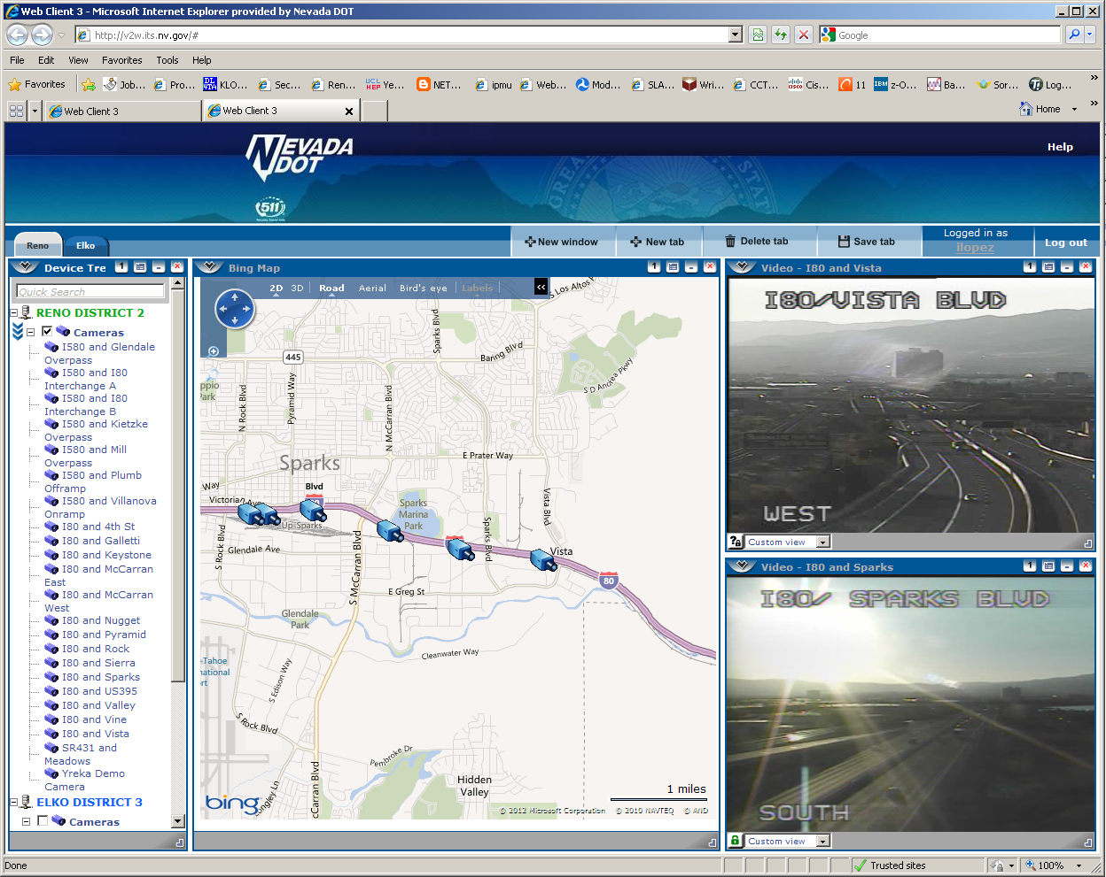
Video to Web
Notes:
v2w.its.dot.state.nv.us

Slide 20
RWIS Web Site

Slide 21
District II ITS Data Dashboard

Slide 22
Questions?

Slide 23
Contact Info
Thor Dyson, PE, CPM
District Engineer
775.834.8300
tdyson@dot.state.nv.us
Mike Fuess, PE, PTOE
District Traffic Engineer
775.834.8300
mfuess@dot.state.nv.us
John Talbott
NNROC Supervisor
775.834.8365
jtalbott@dot.state.nv.us

